Slide 1
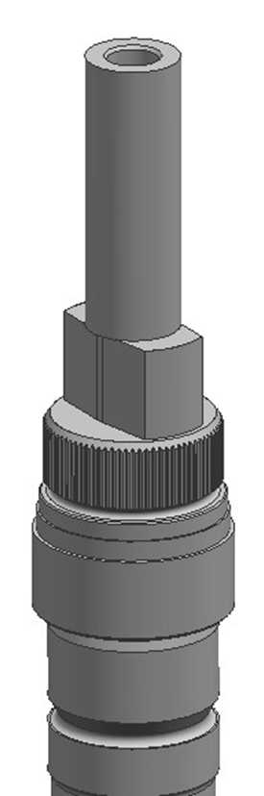
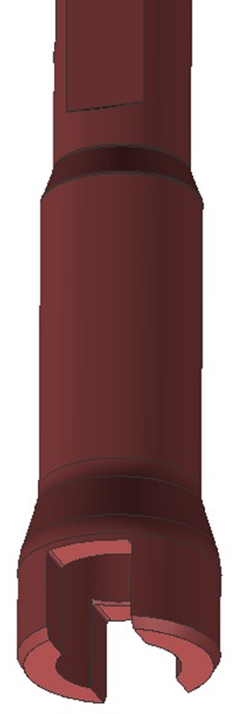
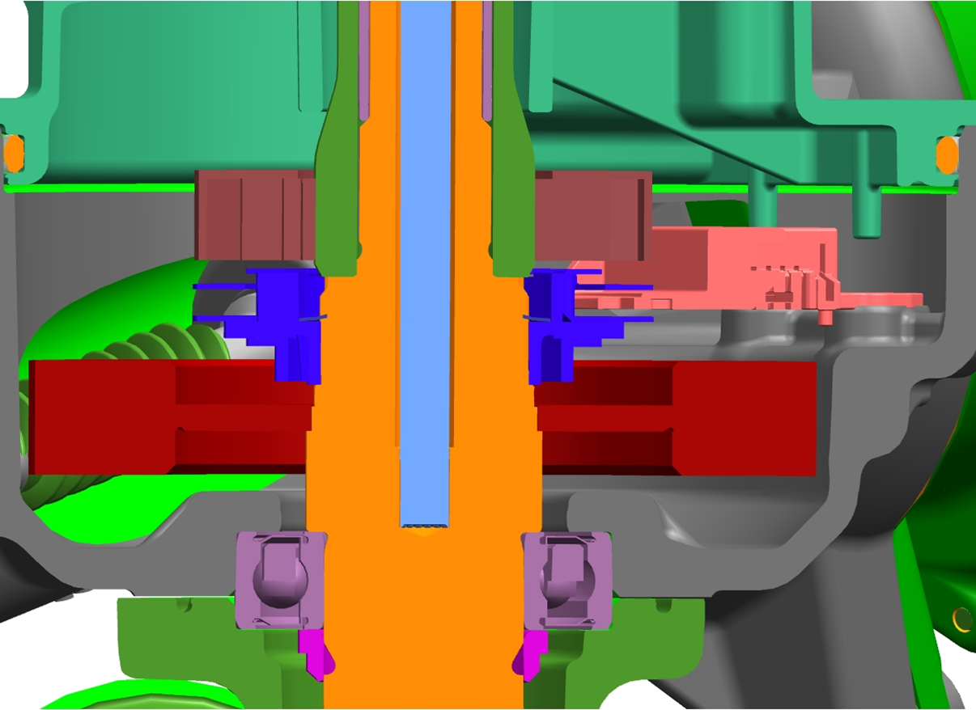
2 Stop Tooth PEPS PSA CMP TRM CCM 166
Last updated: April 14, 2016
Description
Lower cost PEPS 2 stop tooth design to replace legacy 6 tooth design
Coordinated change with duel press T-bar & axial sensor
Design will be significantly affected if the other 2 changes are not implemented
Deliverables
Evaluate prototype performance and durability
Timing
XX - Shaft test completion
XX – AM development test completion
TBD – 1st PSA prototypes expected
TBD – DV
Team Members
Chris Walsh, John Andres, Keith Kidder, Pierre Longuemare, Dave Stearns

Slide 2
2 Stop Tooth PEPS PSA CMP TRM CCM 166
Last updated: April 14, 2016
Status Update:
FEA is complete
Test shafts delivered
Ultimate torque / JAEL testing
Durability testing
Sensor attachment testing
Duel press T-bar testing
Order of PSA CMP shafts
Challenges:
Parallel sensor testing
Parallel duel press T-bar testing
PSA packaging of axial sensor
Next Actions:
Evaluation of prototype test shafts
Order PSA developmental shafts

